Slide 1
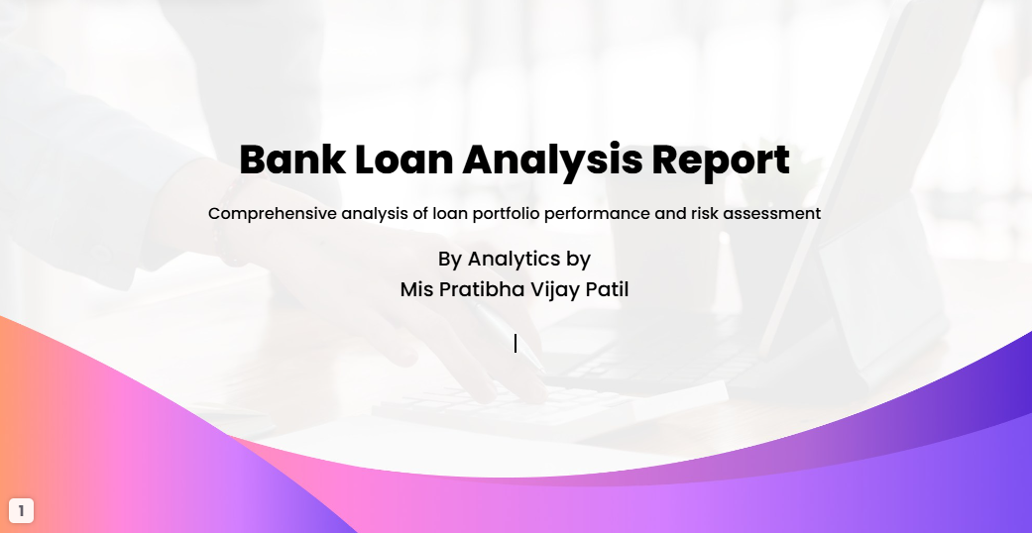

Slide 2
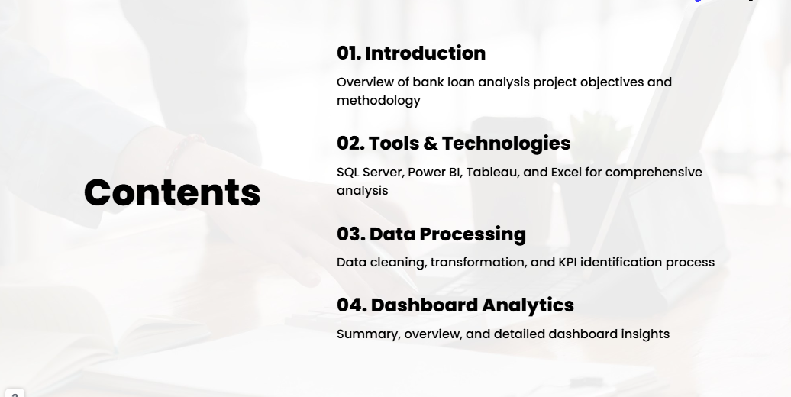

Slide 3
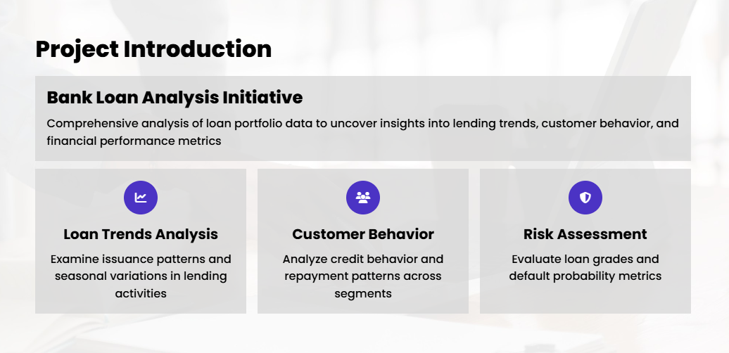
This project is in-depth analysis of bank loan data, aimed at uncovering key insights in to loan issuance trends, customer credit behavior, and financial performance metrics. The analysis combines SQL, Tableau, Excel and Power BI for data extraction and transformation into data visualization , providing a comprehensive overview of loan trends and over time, the financial health of different customer segment and risk assessment across various loan grades. This projects serves as a crucial tool for understanding the dynamics of loan portfolios and guiding strategic decision-making in the financial sector.

Slide 4
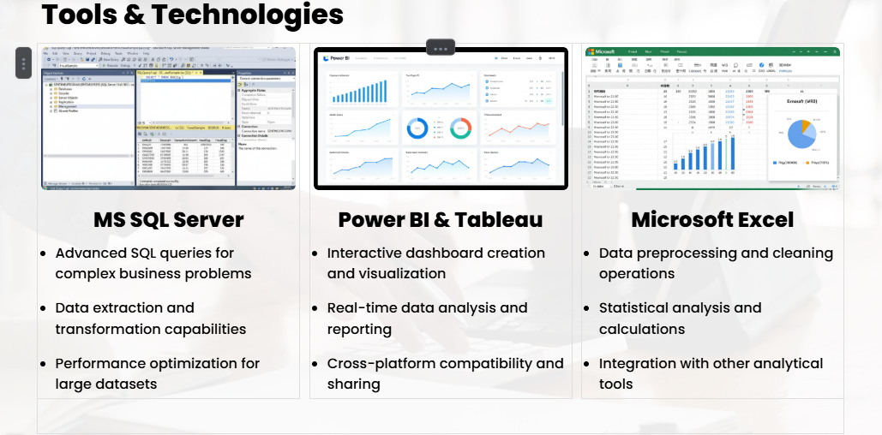

Slide 5
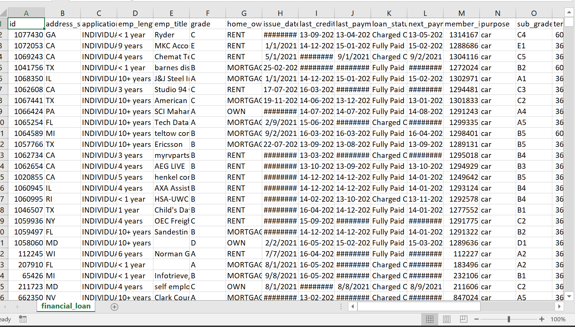
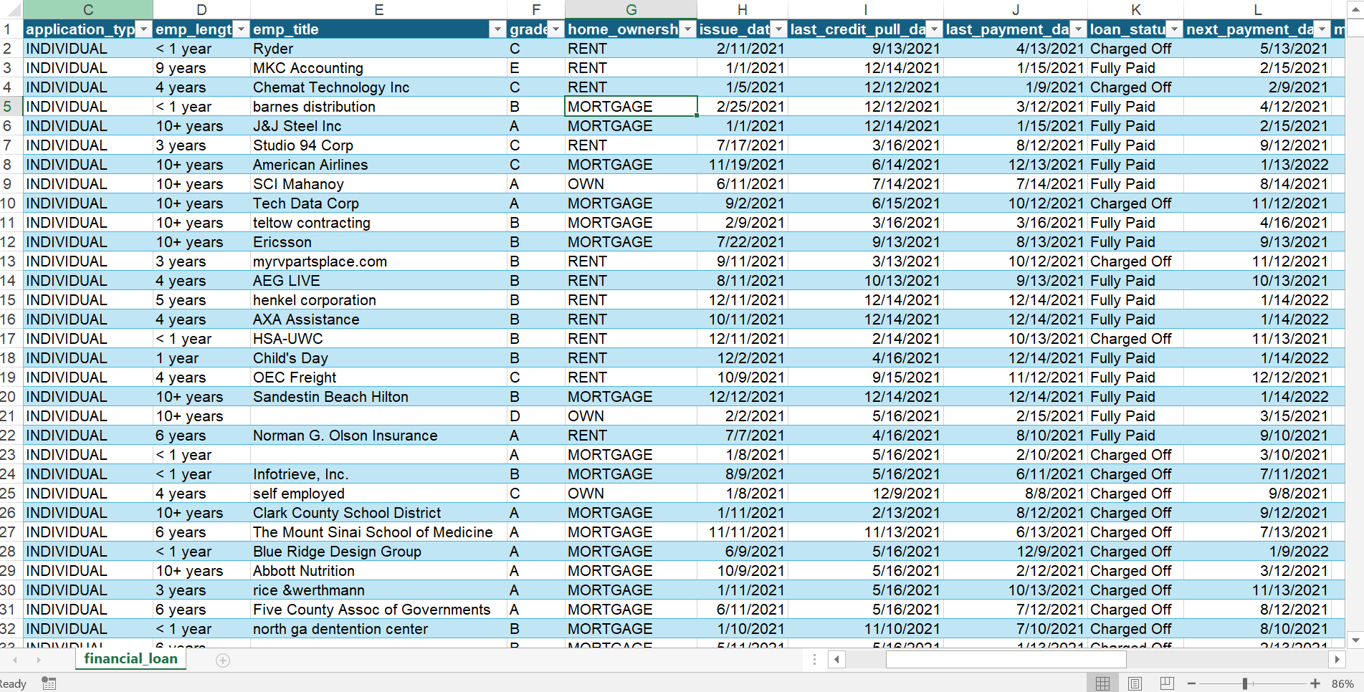
DATASETS
THIS TWO DATASETS USED FOR ANALYSIS.

Slide 6
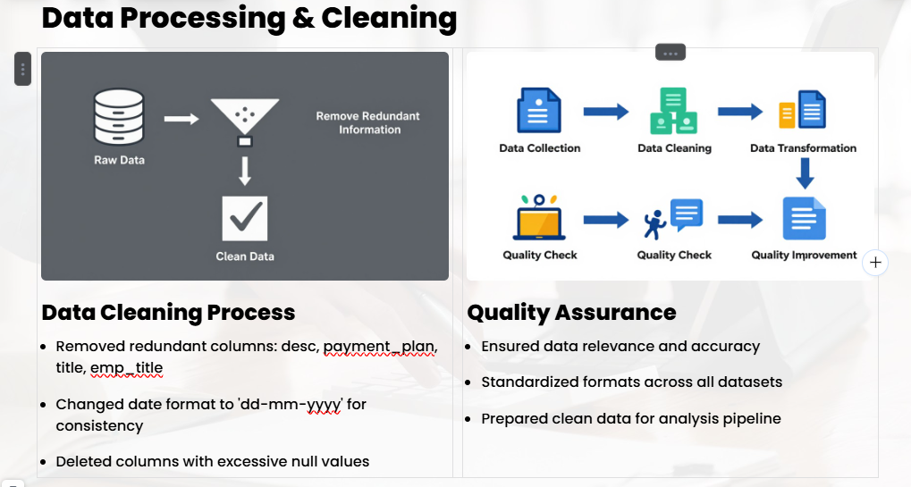

Slide 7
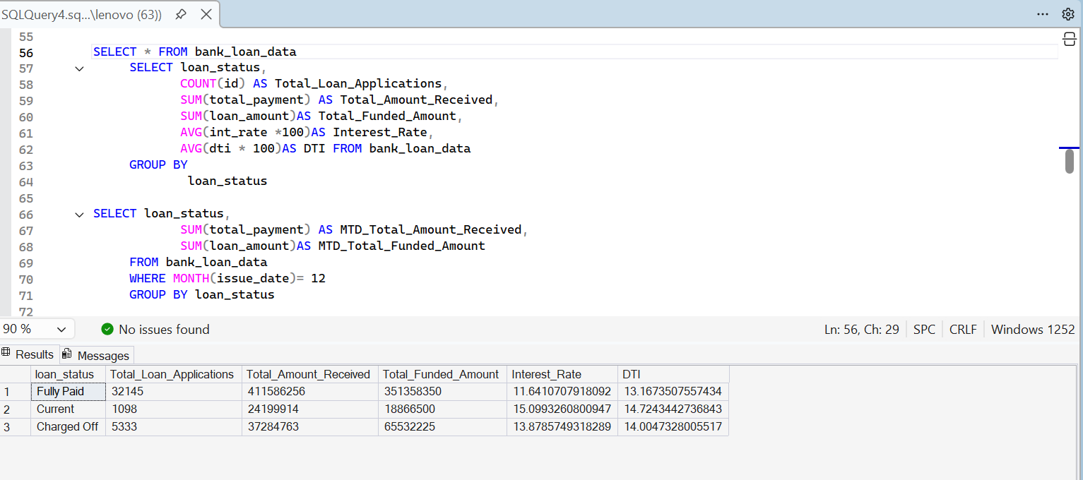
MS SQL SERVER
SQL QUERIES TO SOLVE THE BUSINESS PROBLEM COMPARING RESULT
WITH POWER BI, TABLEAU, EXCEL.

Slide 8
BANK LOAN REPORT PROJECT AND DASHBOARD VIEW PART-2

Slide 9
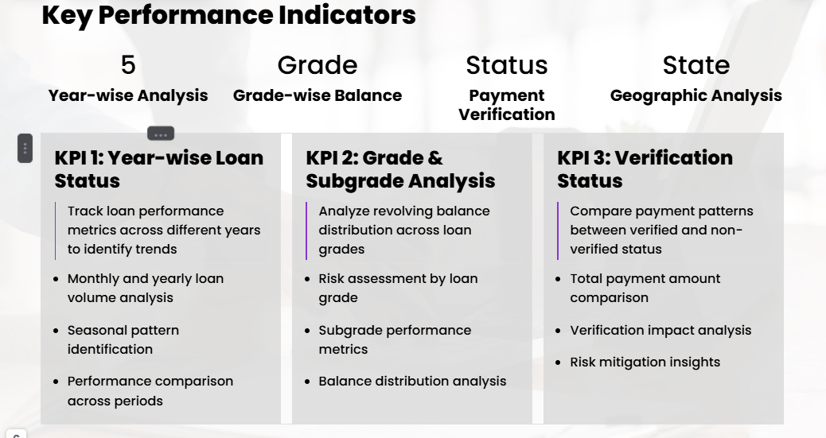

Slide 10
BANK LOAN ANALYSIS REPORT
DOMAIN KNOWLEDGE:
Welcome to the Bank Loan Analysis Power BI project repository! This project aims to provide insightful analysis and visualization of bank loan data using Power BI.
Bank loans are a crucial financial tool that enables individuals and businesses to achieve their goals and manage financial needs. However, it's essential for borrowers to understand the terms, costs, and responsibilities associated with loans to make informed financial decisions.
Banks collect loan data through various channels and processes, including:
Loan Applications: When individuals or businesses apply for loans, they submit detailed applications that include personal and financial information. This data is collected electronically or in paper form.
Credit Reports: Banks often access credit reports from credit bureaus when assessing a borrower's creditworthiness. These reports contain information about a person's credit history, existing loans, and payment behavior.
Internal Records: Banks maintain internal records of loan transactions, including disbursements, repayments, and loan status changes. These records are generated and stored in the bank's database.
Online Portals: Many banks offer online platforms where borrowers can apply for loans, make payments, and access account information. Data from these portals is collected and stored for analysis.
Third-party Data Sources: Some banks may use external data sources, such as income verification services, to gather additional information about borrowers.

Slide 11
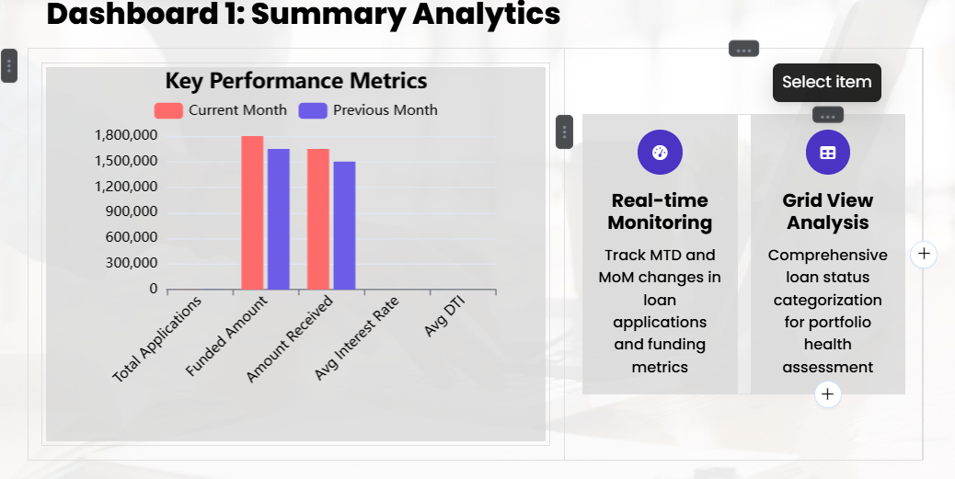

Slide 12
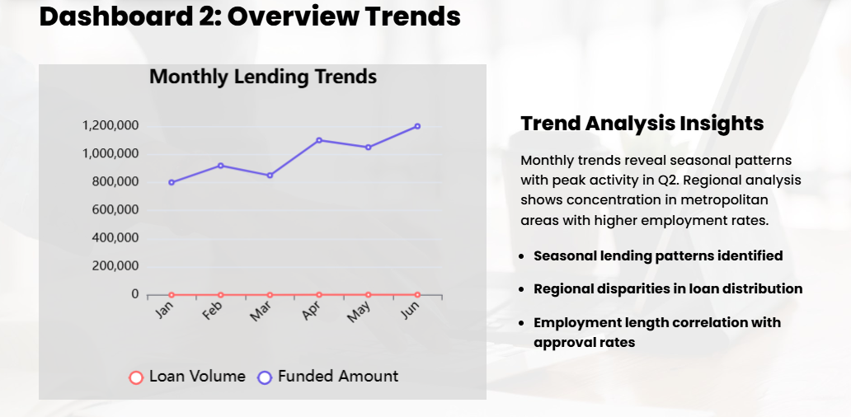

Slide 13
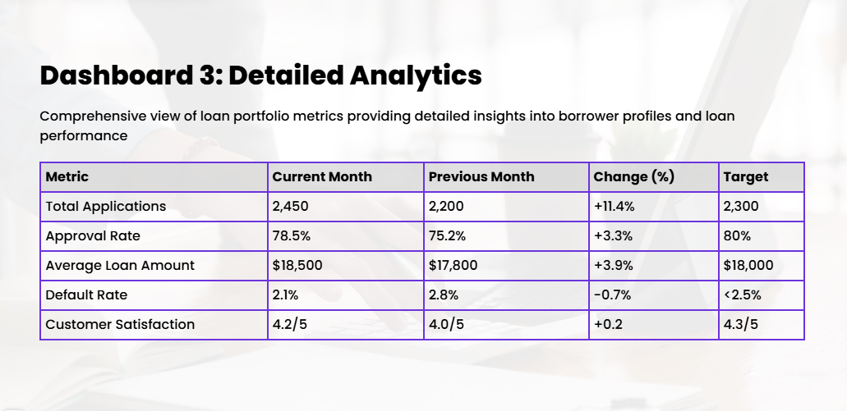

Slide 14
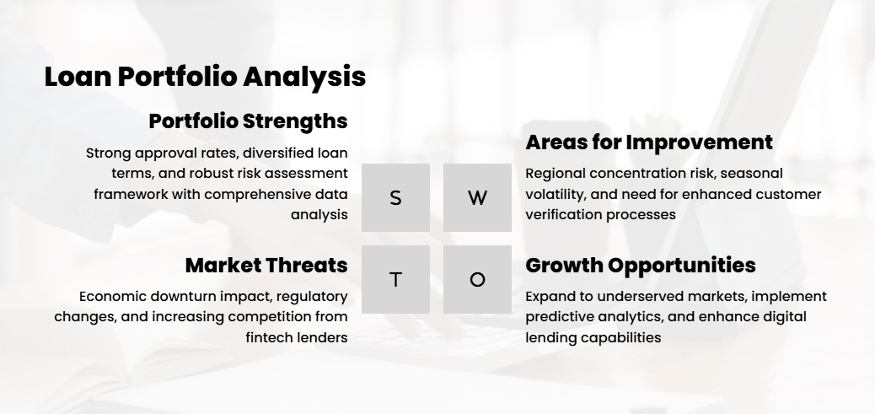
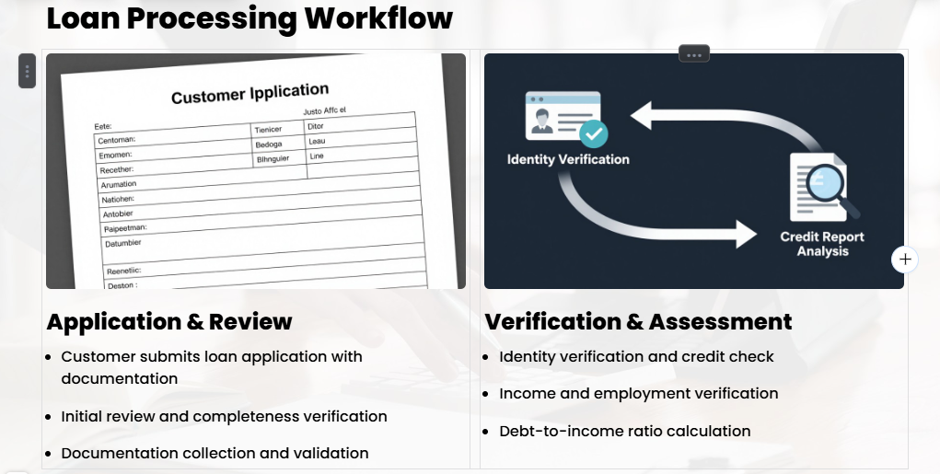

Slide 15
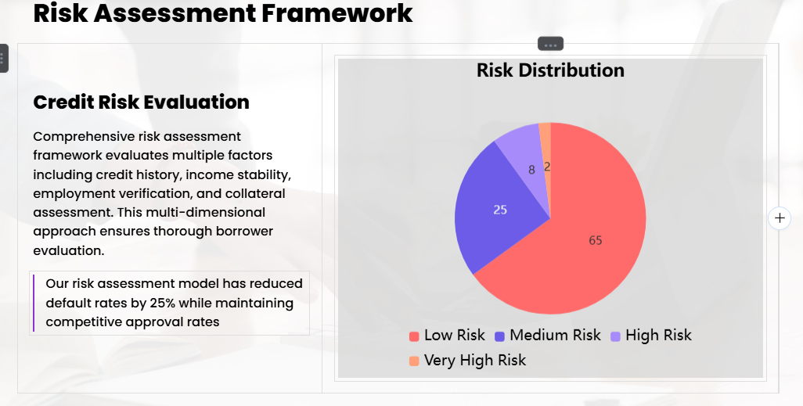
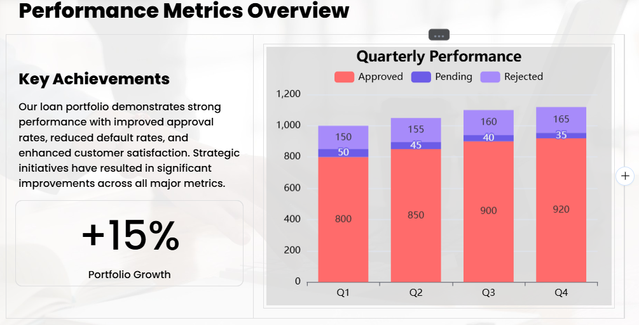

Slide 16
DETAILS REPORT ON POINT TO POINT MENTION UNDER

Slide 17
Process of Granting a Loan
Loan Application:
The process begins when a customer submits a loan application to a bank or lending institution. This application can be submitted in person, online, or through other channels.
Application Review:
The lending institution reviews the loan application and collects necessary documentation, such as income statements, credit reports, and identification documents.
Identity Verification:
One of the initial checks is to verify the applicant's identity. This helps ensure that the applicant is who they claim to be and prevents identity theft.
Credit Check:
A crucial step is to perform a credit check on the applicant. This involves accessing their credit report from credit bureaus. Lenders evaluate the applicant's credit history, credit score, and any past delinquencies or defaults.
Income Verification:
Lenders assess the applicant's ability to repay the loan by verifying their income. This may involve reviewing pay stubs, tax returns, or other income documentation.
Debt-to-Income Ratio (DTI) Check:
Lenders calculate the applicant's DTI, which is the ratio of their monthly debt payments to their monthly income. A lower DTI indicates better repayment capacity.

Slide 18
Lenders calculate the applicant's DTI, which is the ratio of their monthly debt payments to their monthly income. A lower DTI indicates better repayment capacity.
Employment Verification:
Lenders may contact the applicant's employer to verify their employment status and length of employment. Stable employment history is often seen as a positive factor.
Collateral Assessment (if applicable):
If the loan is secured by collateral, such as a home or a car, the lender evaluates the value and condition of the collateral.
Risk Assessment:
Lenders assess the overall risk associated with the loan. This includes considering the applicant's credit risk, income stability, and the purpose of the loan.
Loan Approval or Denial:
Based on the information gathered and the risk assessment, the lender makes a decision to approve or deny the loan application. If approved, the lender determines the loan amount, interest rate, and terms.
Loan Agreement:
If the loan is approved, the lender provides the applicant with a loan agreement that outlines the terms and conditions, including the interest rate, repayment schedule, and any fees.

Slide 19
Disbursement of Funds:
Once the loan agreement is signed by both parties, the lender disburses the funds to the borrower. The borrower can use the funds for the specified purpose.
Repayment:
The borrower is responsible for making regular loan payments as specified in the loan agreement. This includes repaying the principal amount along with interest.
Ongoing Monitoring:
Lenders continue to monitor the loan throughout its term, including tracking payments, assessing the borrower's financial health, and managing any delinquencies or defaults.

Slide 20
Reasons for Analyzing Bank Loan Data:
Banks analyze loan data for several critical reasons:
Risk Assessment: One of the primary purposes of analysing loan data is to assess the risk associated with lending to a particular individual or business. Banks use data to evaluate the creditworthiness of borrowers, predict default probabilities, and determine interest rates and lending terms.
Decision-making: Loan data analysis supports the decision-making process when evaluating loan applications. Banks use data-driven models and algorithms to make informed lending decisions, such as approving or denying loan requests.
Portfolio Management: Banks manage portfolios of loans, including mortgages, personal loans, and business loans. Data analysis helps banks monitor the health of these portfolios, identify underperforming loans, and optimize loan terms and pricing.
Fraud Detection: Banks use data analysis to detect fraudulent loan applications and activities. Unusual patterns, inconsistencies, or discrepancies in loan data can trigger fraud alerts.
Regulatory Compliance: Banks are subject to regulatory requirements that mandate the collection and reporting of loan data. Compliance with regulations such as the Home Mortgage Disclosure Act (HMDA) and the Know Your Customer (KYC) regulations requires data analysis and reporting.
Customer Insights: Analysing loan data provides insights into customer behaviour, preferences, and needs. Banks can use these insights to tailor loan products and marketing strategies to specific customer segments.
Profitability Analysis: Banks assess the profitability of their loan portfolios by analysing data related to interest income, loan origination costs, default rates, and collection efforts.
Market Research: Data analysis helps banks understand market trends, competitive landscape, and customer demand. This information guides product development and market expansion strategies.

Slide 21
Credit Risk Management: Banks continuously monitor and manage credit risk associated with their loans. Data analysis helps in setting risk management strategies, provisioning for potential losses, and stress testing loan portfolios.
Customer Retention: Banks use data analysis to identify opportunities for retaining existing customers, such as offering loan refinancing options or additional financial products.

Slide 22
PROBLEM STATEMENT
DASHBOARD 1: SUMMARY
Key Performance Indicators (KPIs) Requirements:
Total Loan Applications: Calculate the total number of loan applications received during a specified period, including Month-to-Date (MTD) and Month-over-Month (MoM) changes.
Total Funded Amount: Understand the total amount of funds disbursed as loans, monitor MTD Total Funded Amount, and analyze MoM changes.
Total Amount Received: Track the total amount received from borrowers to assess cash flow and loan repayment, including MTD Total Amount Received and MoM changes.
Average Interest Rate: Calculate the average interest rate across all loans, MTD, and monitor MoM variations.
Average Debt-to-Income Ratio (DTI): Evaluate the average DTI for borrowers, compute the average DTI for all loans, MTD, and track MoM fluctuations.
Loan Status Grid View: In order to gain a comprehensive overview of lending operations and monitor loan performance categorized by 'Loan Status'. This grid view provides insights into metrics such as Total Loan Applications, Total Funded Amount, Total Amount Received, MTD Funded Amount, MTD Amount Received, Average Interest Rate, and Average DTI,’ this grid view will empower us to make data driven decisions and assess the health of our loan portfolio.

Slide 23
PROBLEM STATEMENT
DASHBOARD 2: OVERVIEW
CHARTS
Monthly Trends by Issue Date (Line Chart): To Identify seasonality and long-term trends in lending activities.
Regional Analysis by State (Filled Map): To Identify regions with significant lending activity and assess regional disparities.
Loan Term Analysis (Donut Chart): To allow the client to Understand the distribution of loans across various term lengths.
Employee Length Analysis (Bar Chart): How lending metrics are distributed among borrows with different employment lengths, helping us assess the impact of employment history on loan applications.
Loan Purpose Breakdown (Bar Chart): Will Provide a visual breakdown of loan metrics based on stated purposes of loan, aiding in the understanding of the primary reasons borrowers seek financing.
Home Ownership Analysis (Tree Map): For a hierarchical View how home ownership impacts loan applications and disbursements.

Slide 24
PROBLEM STATEMENT
DASHBOARD 3: DETAILS
GRID
In our Bank Loan Report project, we recognize the need for a comprehensive 'Details Dashboard' that provides a consolidated view of all the essential information within our loan data. This Details Dashboard aims to offer a holistic snapshot of key loan-related metrics and data points, enabling users to access critical information efficiently. Details Dashboard provides a comprehensive view of key loan-related metrics and data points, facilitating efficient access to critical information about loan portfolios, borrower profiles, and loan performance.
Objective:
The primary objective of the Details Dashboard is to provide a comprehensive and user-friendly interface for accessing vital loan data. It will serve as a one-stop solution for users seeking detailed insights into our loan portfolio, borrower profiles, and loan performance.

Slide 25
POWER BI DASHBOARD

Slide 26
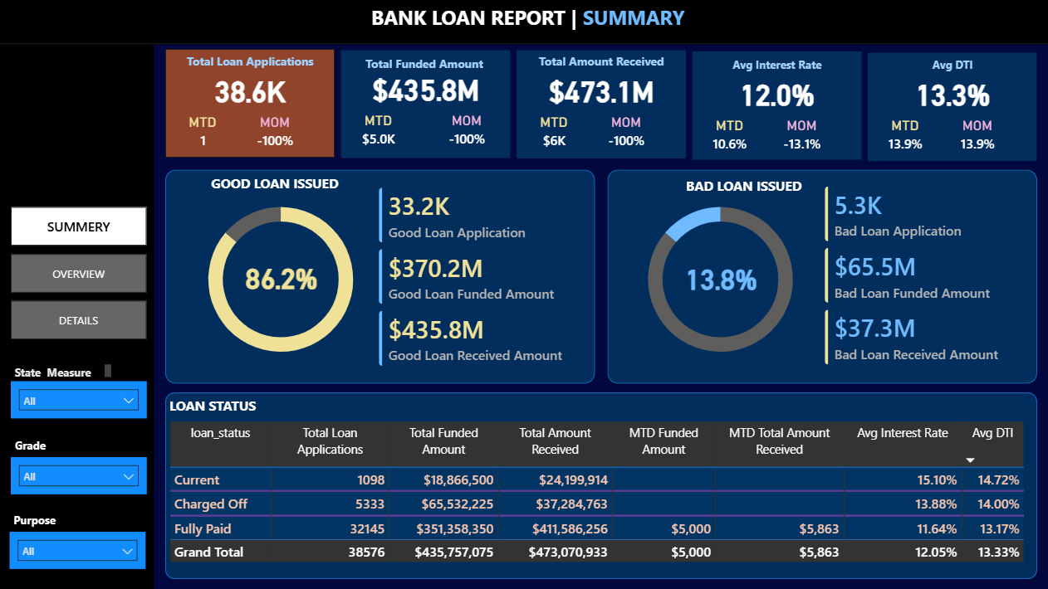
POWER BI DASHBOARD

Slide 27
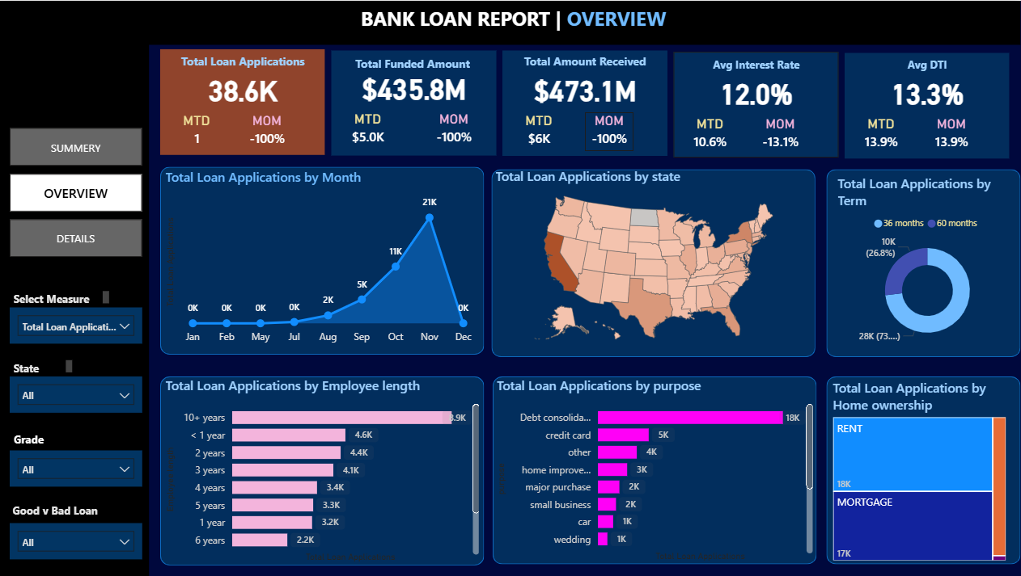
POWER BI DASHBOARD

Slide 28
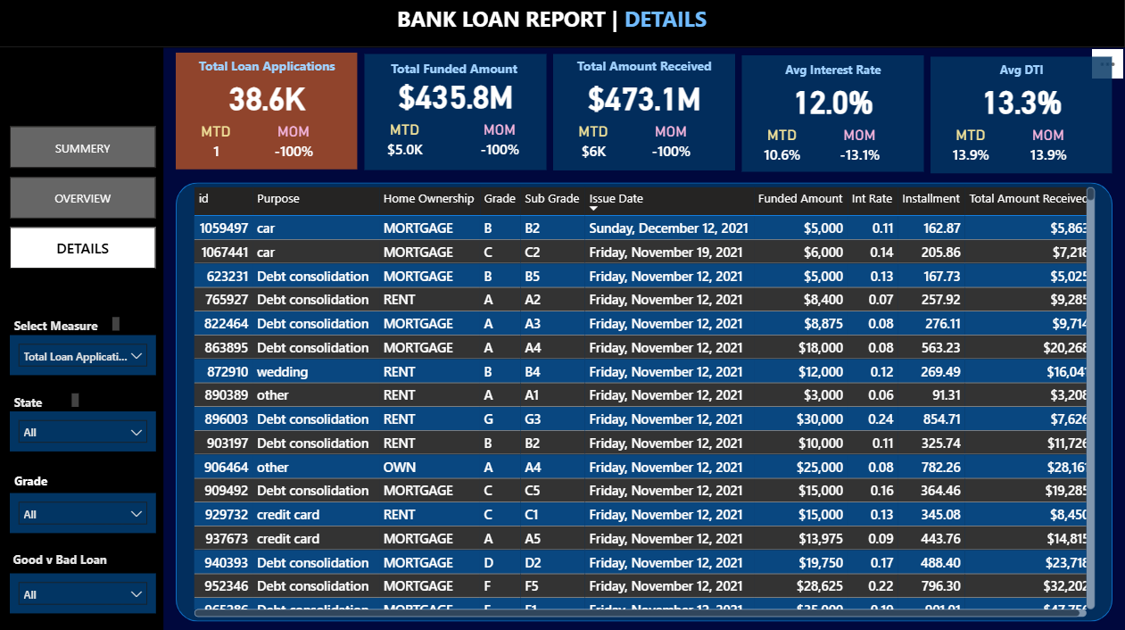
POWER BI DASHBOARD

Slide 29
TABLEAU DASHBOARD

Slide 30
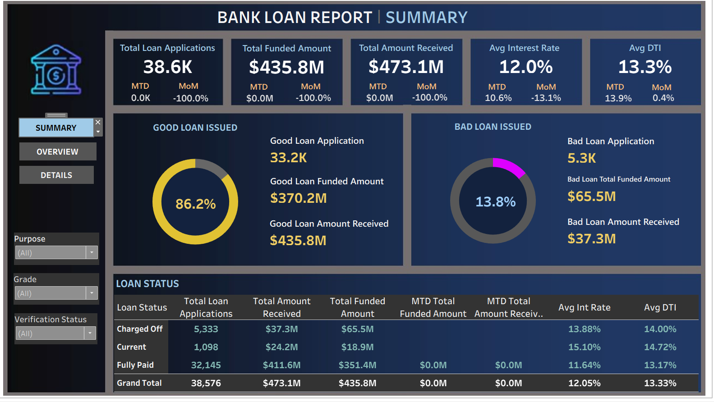
TABLEAU DASHBOARD

Slide 31
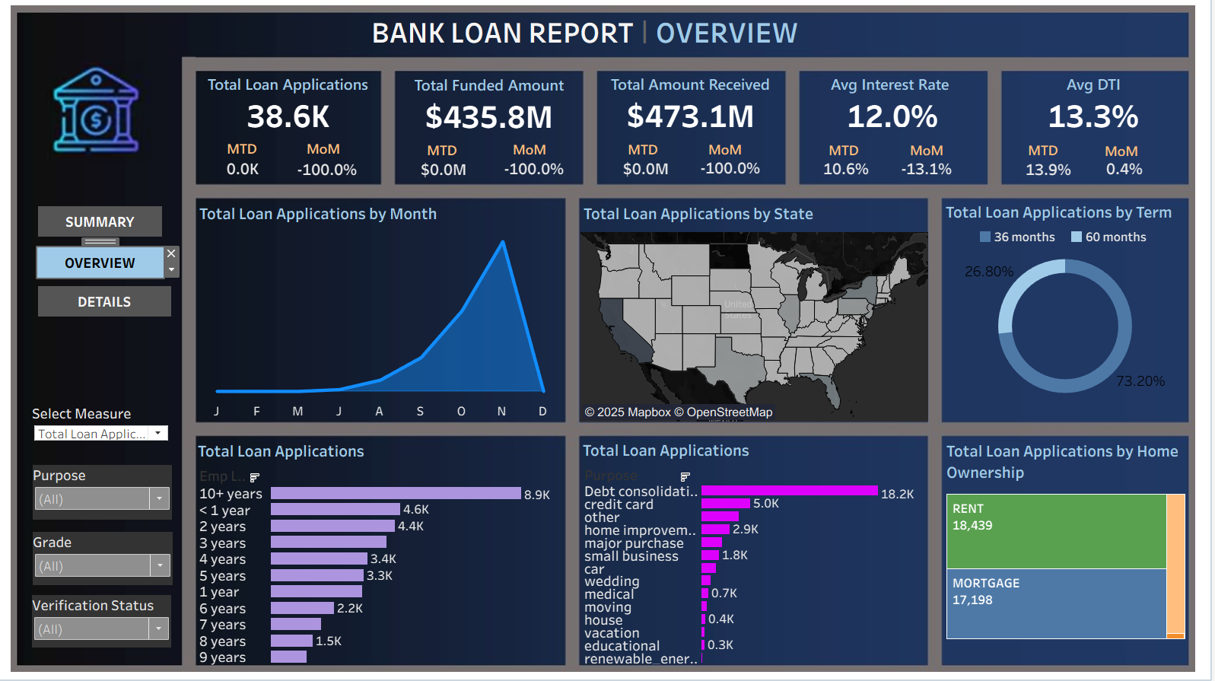
TABLEAU DASHBOARD

Slide 32
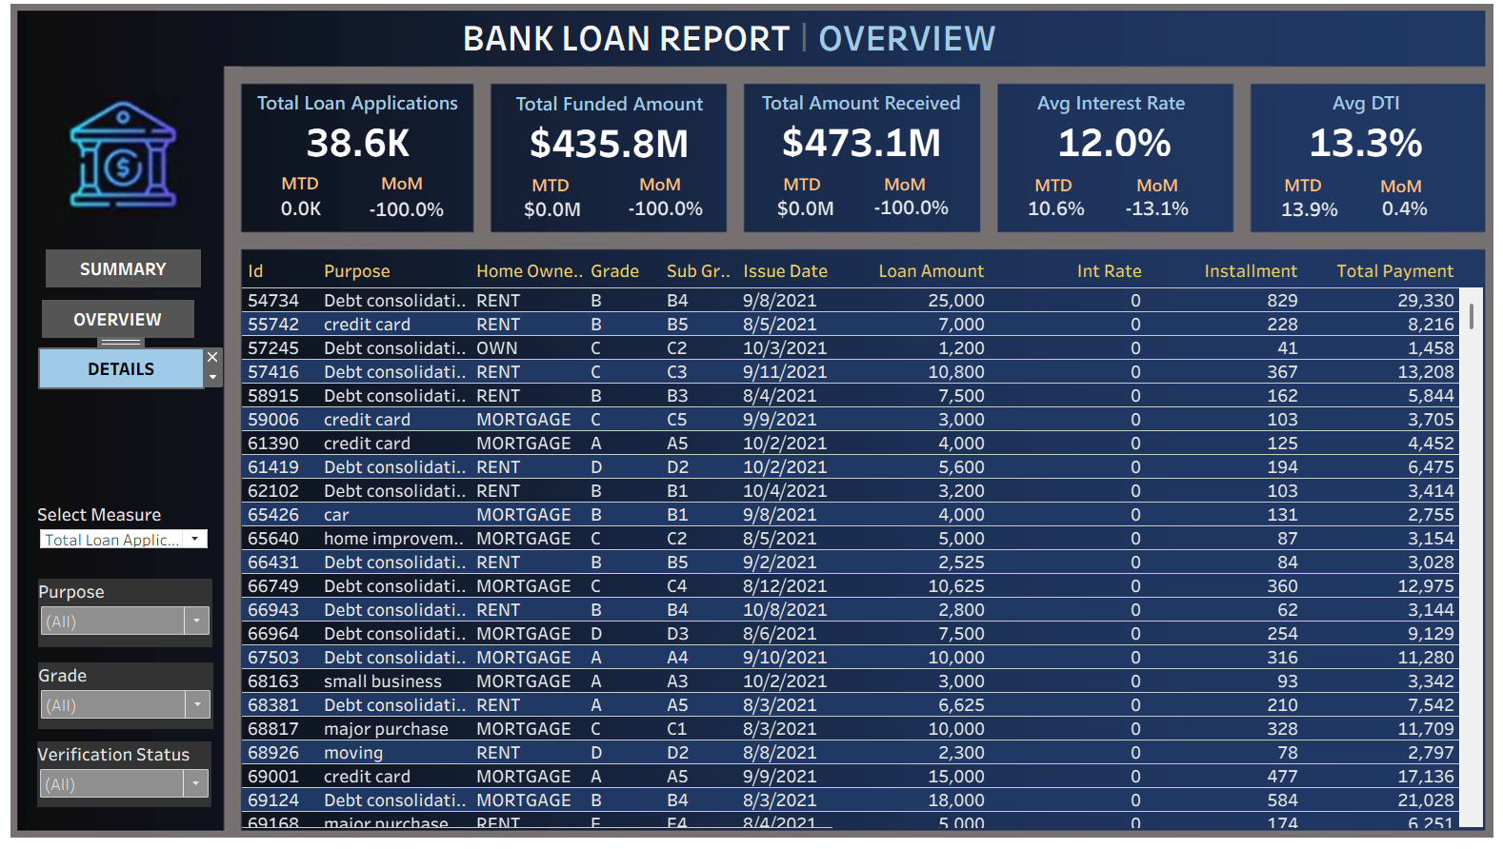
TABLEAU DASHBOARD

Slide 33
EXCEL DASHBOARD

Slide 34
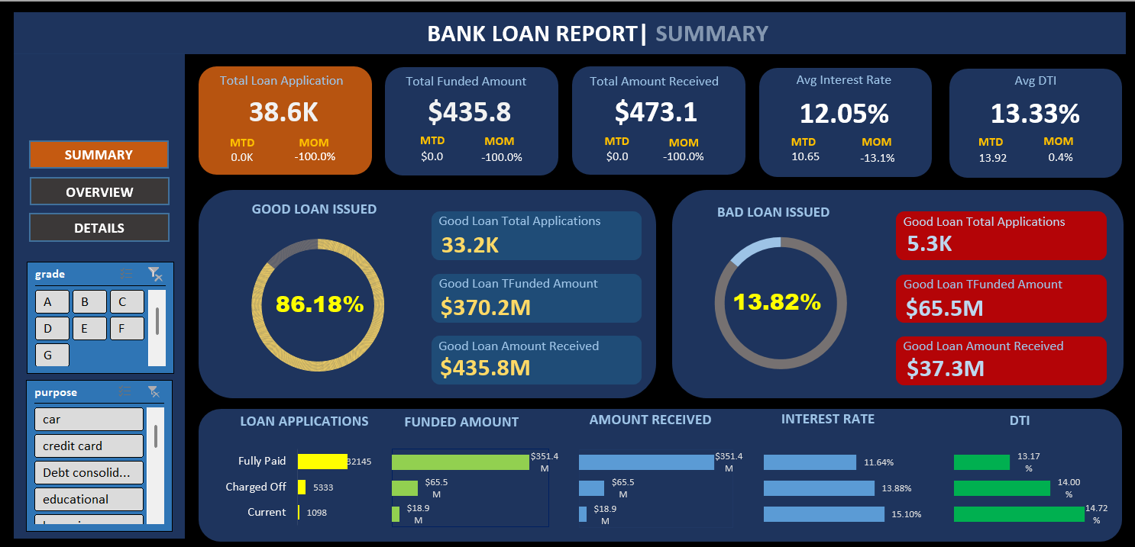
EXCEL DASHBOARD

Slide 35
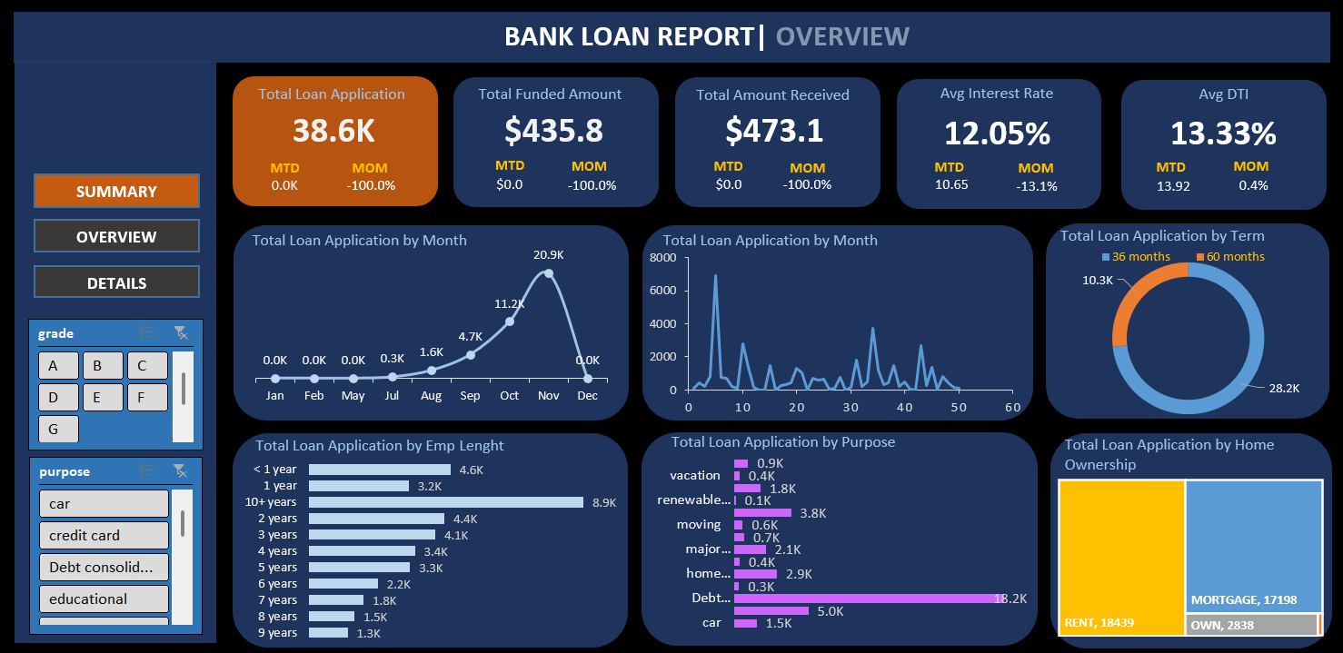
EXCEL DASHBOARD

Slide 36


